Slide 1
Special Economic Zone and Noodle Bowl Effect: A case study on CPFTA
Author: Hummaira Jabeen-
Assistant Professor/Program Manager
Indus University, Karachi

Slide 2
Key Concepts
Introduction
Literature Review
Method
Test
Conclusion

Slide 3
Key Concepts
Free Trade Agreements (FTAs) are bilateral in nature and aim to strengthen trade between both countries.
Special Economic Zones (SEZs) which help in establishing a liberal market economy (African Union Commission, 2018)
It arises due to different rules of origin and technical standards that add cost to businesses and stop them from entering FTAs (Kang,2015).
Causation running from exports to economic growth is known as export led growthWorld Bank (1987) .
Notes:
The economies that have relied on exports for economic growth have been quite successful after implementing it.
Prominent example can be seen in case of Asian countries that since sixties have been using this direction for remarkable economic growth.
export-promotion scheme is the best choice for Less Developing Countries (LDCs) attempting to industrialize and transform into more developed economies. The real GDP growth of the export- oriented country was higher than the less export-oriented one.

Slide 4
Research Questions
Does export led growth hypothesis is applicable in case of Pakistan and China?
Does special economic zones helps in dealing with noodle bowl effect of FTAs?

Slide 5
METHODology

Slide 6
Scope
Scope
Markets
Variables
Time Span
China
Pakistan
GDP
Exports
1971-2022
Notes:
Advanced emerging markets (Brazil, Czech Republic, Hungary, Malaysia, Mexico, Poland, South Africa, Taiwan, Thailand, Turkey) and
Secondary Emerging (Chile, China, Colombia, Egypt, India, Indonesia, Pakistan, Peru, Philippines, Russia, UAE) as classified by FTSE (Financial Times Stock Exchange)
Time span will be 1985 to 2015 for study International shock vs. domestic shock.
Quarterly data base , U.S. Effective Federal Funds Rate (FFR), as policy instrument, real GDP, gross fixed capital formation, short term and long term interest rates, all share price index, housing price index, consumer price index, unemployment rate, export, and import prices for U.S. and emerging countries, as a broad measure of financial and economic integration and on financial system’s impact and benchmark stock index of each country.

Slide 7
Analysis

Slide 8
Johansen Cointegration Test
 | Hypothesized No. of CE(s) | Eigenvalue | Trace Statistic | 0.05 Critical Value | Probability
China (Unrestricted Cointegration Rank Test (Trace)-yes
 | None | 0.218285 | 10.40470 | 15.49471 | 0.2509
 | At most 1 | 0.001464 | 0.061543 | 3.841466 | 0.8041
China (Unrestricted Cointegration Rank Test (Maximum Eigenvalue)-NO
 | None | 0.218285 | 10.34315 | 14.26460 | 0.1904
 | At most 1 | 0.001464 | 0.061543 | 3.841466 | 0.8041
Pakistan (Unrestricted Cointegration Rank Test (Trace)-No
 | None | 0.138403 | 7.599982 | 15.49471 | 0.5091
 | At most 1 | 0.031478 | 1.343345 | 3.841466 | 0.2464
Pakistan (Unrestricted Cointegration Rank Test (Maximum Eigenvalue)-NO
 | None | 0.138403 | 6.256637 | 14.26460 | 0.5805
 | At most 1 | 0.031478 | 1.343345 | 3.841466 | 0.2464

Slide 9
Special Economic Zones
Till 2018 only 7 SEZs existed, while 6 of them had converted from their earlier status as Industrial estates (IEs) or Industrial Parks (IPs).
However, with the advent of CPEC SEZs, the establishment of SEZs across the country took up pace. As of now, 22 SEZs have been approved, while 21 of them have been notified by the authority.
Notes:
These include, 4CPEC SEZs, 3 Private SEZs (including two Sole Enterprise SEZs), and a Science and Technology Park that is being established by NUST in Islamabad.

Slide 10
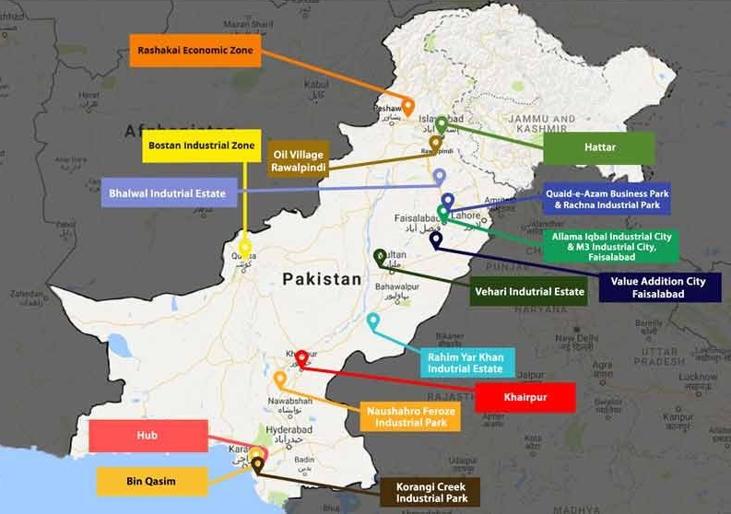
Notified SEZs
https://www.globalvillagespace.com/sezs-and-why-pakistan-needs-them/

Slide 11
SEZs under CPEC
Under Construction Projects | In-Pipeline Projects
Rashakai Special Economic Zone | ICT Model Industrial Zone
Dhabeji Special Economic Zone | Industrial Park on Pakistan Steel Mill Land
Allama Iqbal Industrial City | Mirpur Industrial Zone
Bostan Special Economic Zone | Mohmand Marble City
 | Moqpondass Special Economic Zone

Slide 12
Conclusion & Discussion
According to the results of our study; for the period under investigation, Cointegration is missing in both countries.
SEZs act was amend in 2016 to lesson custom duty. After it a boost can be seen in SEZs (SEZ policy of Pakistan,2021).
Pakistan is at level to address Noodle Bowl Effect.

